Slide 1
Software Effort Estimation

Slide 2
Introduction: Why Estimation is Important
A successful project delivers software on time, within budget, and meets the requirements.
If estimates are wrong, projects may miss deadlines or go over budget, even if the team works hard.
Estimating is hard because software is:
Complex
Invisible
Involves human activities that are not mechanical or predictable

Slide 3
Difficulties
Other difficulties include
Subjective nature of estimating: People often underestimate small tasks and overestimate big ones
Political Implications: Managers may adjust estimates to fit personal or team goals.
Changing Technology:
Lack of homogeneity of project experience:
2

Slide 4
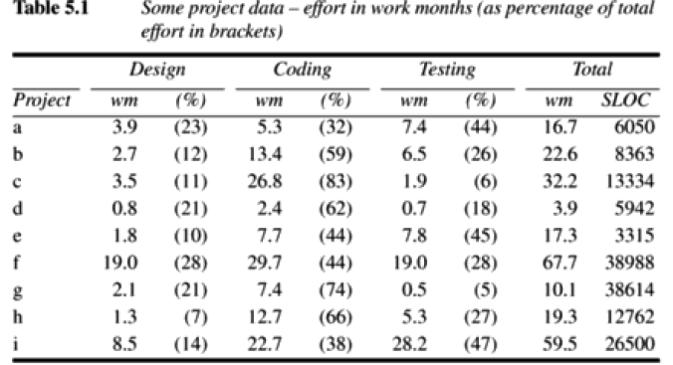
Example
2

Slide 5
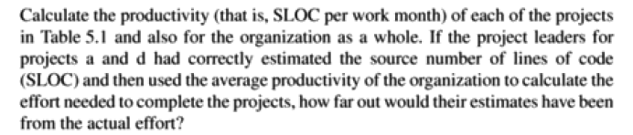
Example (contd..)
2

Slide 6
Example (Contd..)
Estimated Effort (WM)=SLOC/ Average Productivity
Average Productivity = Total SLOC from all projects​/Total Work Months from all projects
2

Slide 7
Where Are Estimates Done?
Strategic Planning
Why? To decide which projects to take up and how much benefit they will bring.
What is estimated?
Cost to build the system
Benefits to the organization
Use: Helps in prioritizing projects and budget planning.
Feasibility Study
Why? To check if the project is practical and worth doing.
What is estimated?
Effort required
Cost involved
Timeline
Use: Helps in deciding whether the benefits justify the costs.
2

Slide 8
Where Are Estimates Done?
System Specification
Why? To estimate effort based on actual requirements and design.
What is estimated?
Time, resources, and cost to implement each part of the system
Use: Helps in confirming feasibility and in detailed project planning.
Evaluation of Supplier Proposals
Why? When software is being outsourced or purchased.
What is estimated?
Suppliers submit proposals with their own time and cost estimates.
The organization must evaluate if the supplier’s estimate is reasonable and reliable.
Use: Helps in selecting the right vendor based on cost, time, and quality.
2

Slide 9
Where Are Estimates Done?
Project Planning
Why? For detailed scheduling and resource allocation.
What is estimated?
How long each task will take
How many people are needed
Dependencies between tasks
Use: Helps in creating a realistic and detailed project plan to manage the entire development process.
2

Slide 10
Problems with Over- and Under-Estimates
If the project is given more time and people than needed:
People may slow down their work (because there’s no urgency).
This is explained by Parkinson’s Law:
“Work expands to fill the time available.” If people are given more time, they will take more time. More staff leads to extra communication and coordination effort.
Example: If a job could be done by 3 people in 2 months, and instead you assign 6 people for 4 months, work might get delayed because of confusion, waiting, and meetings.
2

Slide 11
Problems with Over- and Under-Estimates
What happens when estimates are too low (under-estimate)?
Project may:
Miss deadlines
Produce low-quality software, especially if staff are inexperienced
People rush due to time pressure → results in bugs, shortcuts, and low-quality code.
Sometimes, people may still finish the project under pressure, but:
The quality suffers.
Morale drops.
If staff always work under such pressure, they may become demotivated.
2

Slide 12
Two Important Laws
1. Parkinson’s Law
“Work expands to fill the time available.”
If you give people too much time, they may delay work unnecessarily.
2. Brooks’ Law
“Adding more people to a late project makes it later.”
If a project is behind schedule, just adding people doesn’t help — it increases confusion and communication effort.
2

Slide 13
The Basis for Software Estimating
Need for historical data
Most methods need information about past projects.
If past data is lacking, externally maintained datasets of project performance data can be accessed.
International Software Benchmarking Standards Group (ISBSG) contains data about 4800 projects.
http://isbsg.org
2. Measure of work
Also called the size of the project.
Metrics used to measure the size are SLOC and FP.
SLOC is simpler and it is widely used.
2

Slide 14
The Basis for Software Estimating
Major drawbacks of SLOC are
No precise definition
Difficult to estimate at the start of the project.
Only a code measure
Programmer dependent
Does not consider the code complexity
2

Slide 15
The Basis for Software Estimating
3. Measure of effort
What is a Person-Month (PM)?
It means the amount of work one person can do in 1 month.
Example: If a task takes 10 person-months, it could be done by:
1 person in 10 months
2 people in 5 months
10 people in 1 month
Fred Brooks' Myth:
"Cost varies as a product of men and months, but progress does not."
This means:
Just because you add more people doesn’t mean work finishes faster.
Sometimes, adding more people can actually slow things down
2

Slide 16
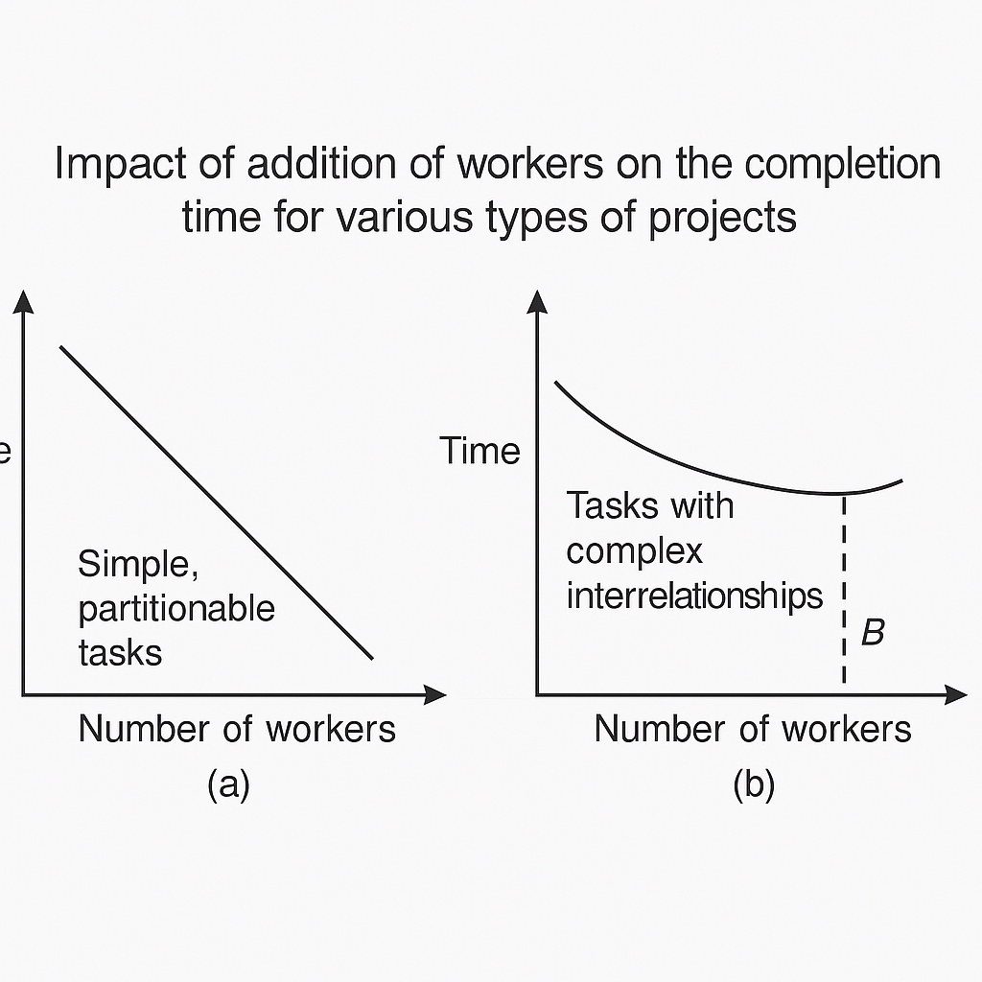
The Basis for Software Estimating
Why Adding People Doesn’t Always Help
You Can’t Always Divide Work Equally
Software work is often not fully partitionable.
Some parts need to be done in sequence, not in parallel.
2

Slide 17
Software Effort Estimation Techniques
Several methods to estimate software development effort are
1. Algorithmic Models
Use mathematical formulas based on 'effort drivers' (e.g., system size, complexity, team skill).
Example: COCOMO
2. Expert Judgement
You ask experienced professionals for their opinion based on similar past work.
Works well when data is not available or the project is new.
3. Analogy
You compare with a similar past project and use that as a benchmark.
Example: "This payroll module is similar to the HR module we did last year."
2

Slide 18
Software Effort Estimation Techniques
4. Parkinson’s Law
Based on the belief that work takes up all the time given to it.
Not a real estimation method, just a way to allocate time.
5. Price to Win
You choose an estimate that satisfies the client or helps win a contract.
Not based on real effort — more of a business strategy than estimation.
6. Top-down Estimating
Start with a whole project estimate, then break it into sub-tasks.
Good for early stages of a project when not many details are known.
7. Bottom-up Estimating
Start by estimating individual tasks and then sum them for the total effort.
More accurate, but requires detailed knowledge of each task.
2

Slide 19
Bottom-up Estimating
Number and type of software modules in the final system.
Estimate the SLOC of each identified module
Estimate the work content, taking into account complexity and technical difficulty.
Calculate the work-days effort
2

Slide 20
Top-Down Estimating
· In this method, you first estimate the total effort for the entire project, then break it down into smaller parts or tasks.
· It is usually used early in the project, when the full details are not yet known.
· Based on past experience, project size, and type, the overall time and cost are guessed, then distributed to different phases like design, coding, and testing.
Parametric models are mathematical models that calculate effort based on input parameters.
General Formula:
Effort = System Size × Productivity Rate
Parameters might include:
System size (like KLOC — thousand lines of code)
Productivity (e.g., 40 workdays per KLOC)
2

Slide 21
Top-Down Estimating
Let’s say the estimates:
Module size = 2 KLOC (2000 lines of code)
Two developers:
A (Experienced):
Productivity = 40 days/KLOC
Effort = 2 × 40 = 80 days
B (Less experienced):
Productivity = 55 days/KLOC
Effort = 2 × 55 = 110 days
This shows how the person’s skill affects effort, even with same code size.
2

Slide 22
Expert Judgement
· Expert Judgement means asking someone with experience or deep knowledge (an expert) to estimate the effort needed for a task.
· It’s useful when:
The project is new or complex
There’s no historical data
Or when specific technical knowledge is needed
2

Slide 23
Estimating by Analogy
We compare the current project (called the target) with a similar past project (called the source).
Then use the effort data from the past project to estimate the effort for the new one.
Find a similar project (same number of inputs, outputs, users, size, etc.)
Measure the difference between the source and the target
Adjust the past estimate based on those differences
2

Slide 24
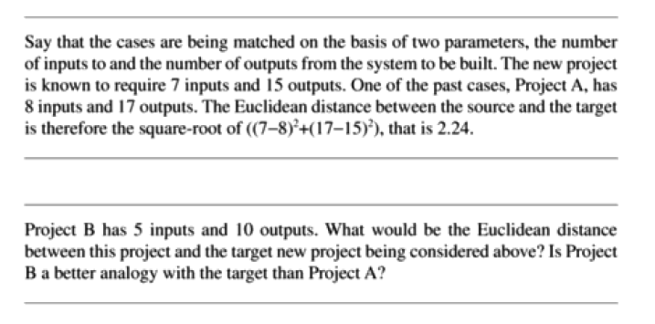
Estimating by Analogy
2

Slide 25
Function Point Analysis
FPA is a top-down estimation technique developed by Allan Albrecht at IBM.
It helps estimate software size and effort by measuring its functionality — not lines of code.
It is independent of programming language.
2

Slide 26
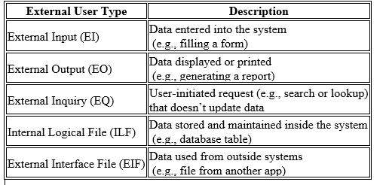
Components in Function Point Counting
2

Slide 27
Step-by-step FPA process
Step 1: Identify Each External User Type
Count how many inputs, outputs, files, inquiries the system has.
Step 2: Classify Each One by Complexity
Each function is classified as Low, Average, or High complexity.
Complexity is based on:
Number of file types accessed
Number of data types used
Record types and file references
2

Slide 28
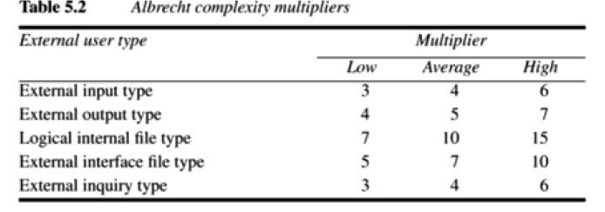
Step-by-step FPA process
2

Slide 29
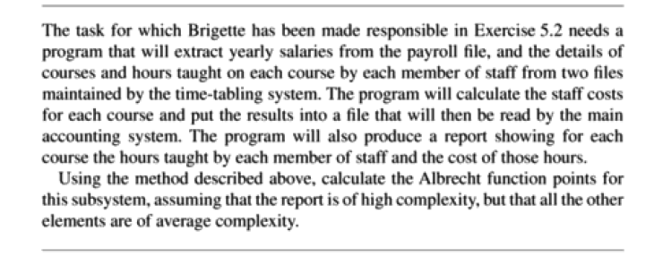
Problem
2

Slide 30
Solution
2

Slide 31
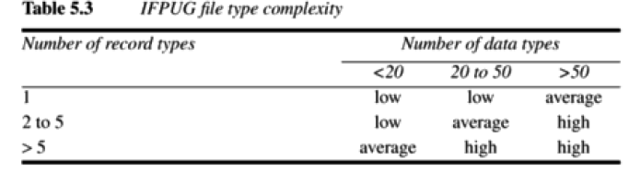
Step-by-step FPA process
2

Slide 32
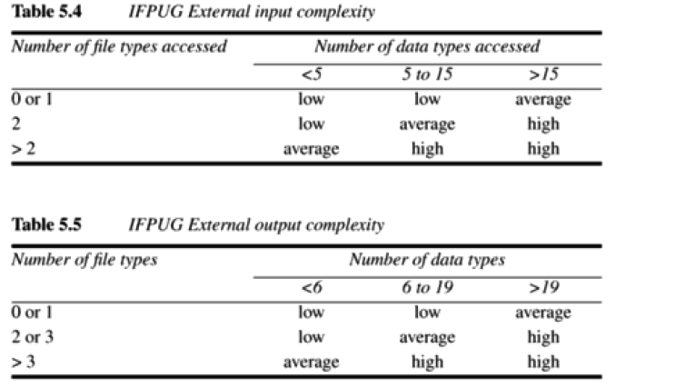
2

Slide 33
Function Points Mark - II
FP-II was introduced to make effort estimation more structured, data-driven, and easy to apply to real-world systems. It emphasizes consistency, objectivity, and automation — especially useful in environments like government IT projects.
Function Points Mark II is a refined version of the original Albrecht Function Point Analysis. It was developed and recommended by the UK (now part of the UK government’s standards for software projects).
It improves Albrecht’s model by:
Focusing more clearly on logical transactions (input → process → output)
Assigning weights to different elements based on industry norms or company experience
2

Slide 34
Function Points Mark - II
UFP = (Wi × # input data elements) + (We × # entity types) + (Wo × # output data elements)
Industry standard weights (from 1999) are:
Wi = 0.58
We = 1.66
Wo = 0.26
2

Slide 35
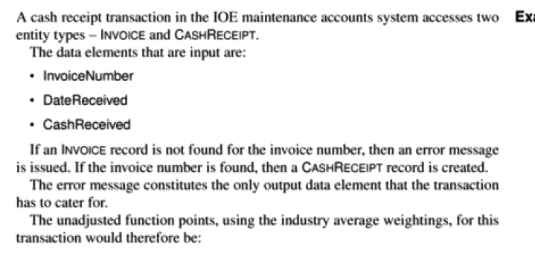
Function Points Mark - II
2

Slide 36
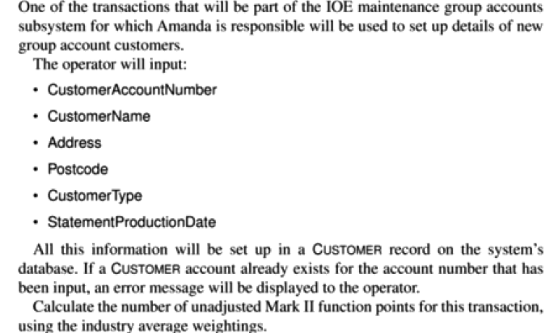
Function Points Mark - II
2

Slide 37
Object Point
Like Function Point Analysis, Object Points is another technique to estimate the size and, consequently, the effort required to build a software application. While Function Points focus on the functions a system performs, Object Points zoom in on the components that users typically interact with.
Object Points measure the size of a software application by counting and categorizing the number of screens, reports, and 3GL components it contains. It's a way to quantify the parts of the software that the user sees or directly uses.
2

Slide 38
Different Objects
· Screens: These are the interactive displays or forms that users see and interact with to input data or view information.
· Reports: These are documents or displays generated by the system, typically for presenting summarized or detailed information.
· 3GL Components: These refer to code components written in a Third-Generation Language (like Java, C++, Python, etc.) that perform specific tasks and are part of the application's functionality, but might not be a direct screen or report. They represent more complex, custom logic.
2

Slide 39
Calculate Object Points
Identify and Count Components
Determine Complexity for Screens and Reports
Apply Complexity Weightings
Calculate Overall Score
2

Slide 40
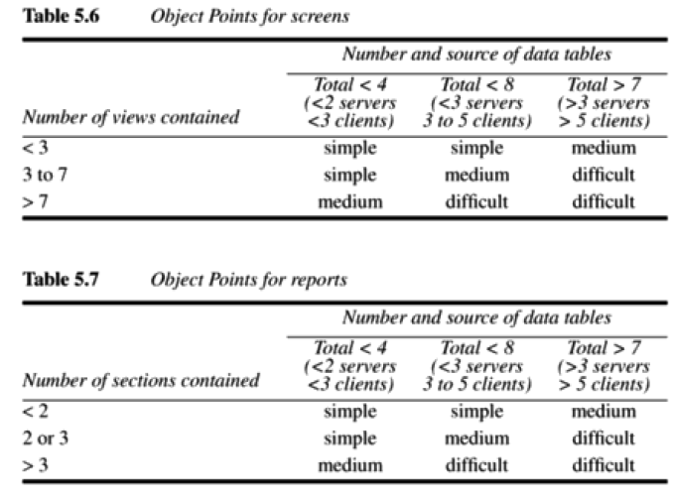
Calculate Object Points
2

Slide 41
Calculate Object Points
2

Slide 42
Calculate Object Points
Number of views contained" (for Screens - Table 5.6)
What it means: For a screen, a "view" refers to a distinct way of presenting or interacting with the information on that screen. Intuition/Example:
Simple Screen (e.g., "Number of views contained < 3"): Imagine a basic login screen. It usually has fields for username and password, and a login button. There's only one way to "view" or interact with it. This would have a low number of views.
2

Slide 43
Calculate Object Points
Medium/Difficult Screen (e.g., "Number of views contained > 7"): Now, think of a complex customer management screen in a bank. It might have:
A tab for "Customer Details".
Another tab for "Account History".
A third section for "Pending Transactions".
A fourth area for "Contact Information" that you can click to expand.
Each of these distinct areas or tabs could be considered a "view" because it shows a different aspect of the data or offers different interactions. The more such distinct views within one logical screen, the more complex it is to design and build.
2

Slide 44
Calculate Object Points
Some components might already exist (e.g., standard login form, reusable report template) and don’t need to be redeveloped.
New Object Points (NOP)=OP×(100−reuse%)/100
Effort (in person-months)=NOP​/PROD
2

Slide 45
COCOMO Model
COCOMO stands for COnstructive COst Model
The basic effort equation is:
Effort=c×(Size)^k
Where:
Effort is in person-months,
Size is in KDSI (thousands of Delivered Source Instructions),
c and k are constants based on the project type (from Table 5.10).
.
2

Slide 46
Calculate Object Points
Organic Mode
Small, simple projects.
Developed by a small team that has strong experience.
Done in a familiar environment with few uncertainties.
The software has flexible requirements, meaning not a lot of change is expected later.
Embedded Mode
Real-time systems or mission-critical software.
Must meet strict requirements (e.g., safety, timing, hardware limits).
Very little flexibility — changes are costly and difficult.
Usually requires deep testing and validation.
2

Slide 47
Calculate Object Points
Semi-detached Mode
A medium-complexity project.
Team may be partially experienced, or the project is partially familiar.
Combines aspects of both Organic and Embedded modes.
2

Slide 48
Calculate Object Points
2

